Slide 1


Thrust-Assisted Controlled Pole Climbing
Laboratory of Intelligent Systems
Jason Mina
Supervisor: Mohammad Askari
Professor: Dario Floreano

Slide 2
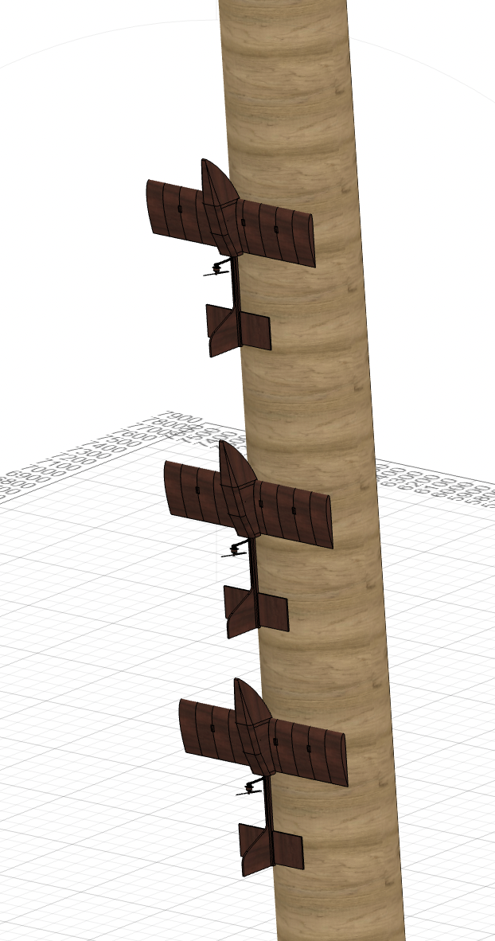
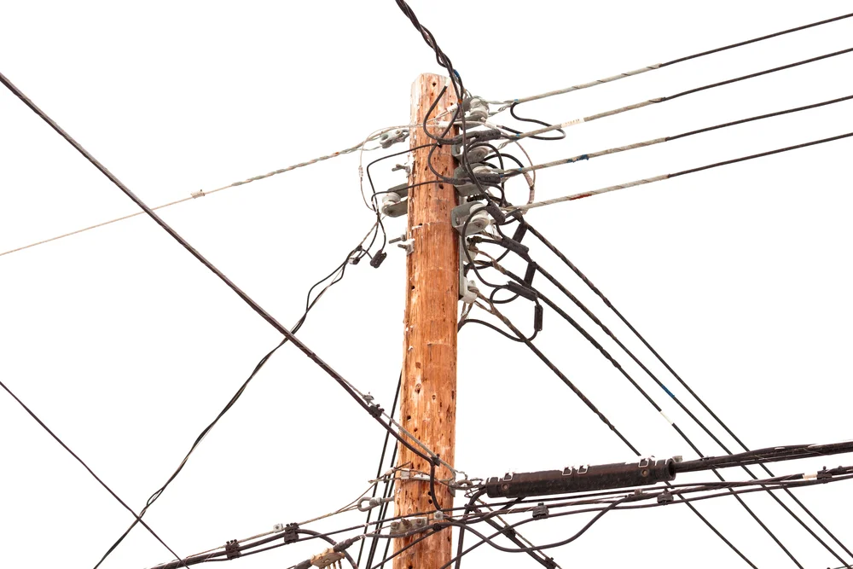
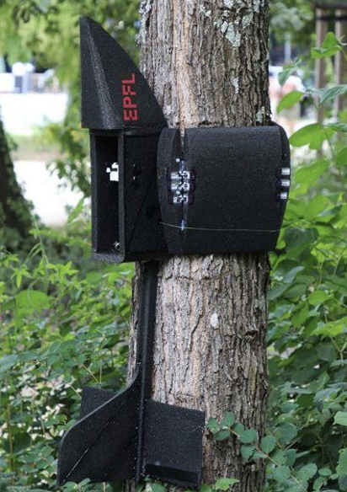
Motivation
LIS Design of Perchug
Inspection Applications
Benefitting from flight range
Climbing Enables Easier Relocation
2/20
Notes:
(perching to save energy, make applications like inspection, motivate from aappraoach f inspection, when we perch, we fly towards an uncluttered area 9utility pole for example (picture) power lines on the top, on the bottom it is open (perch lower end, get to are of interest in more controlled manner, perch more safely withou having tof perch in cluttered area.
ADD picture pf utility pole
We need to look at if there are technologies already developed to do climbing

Slide 3
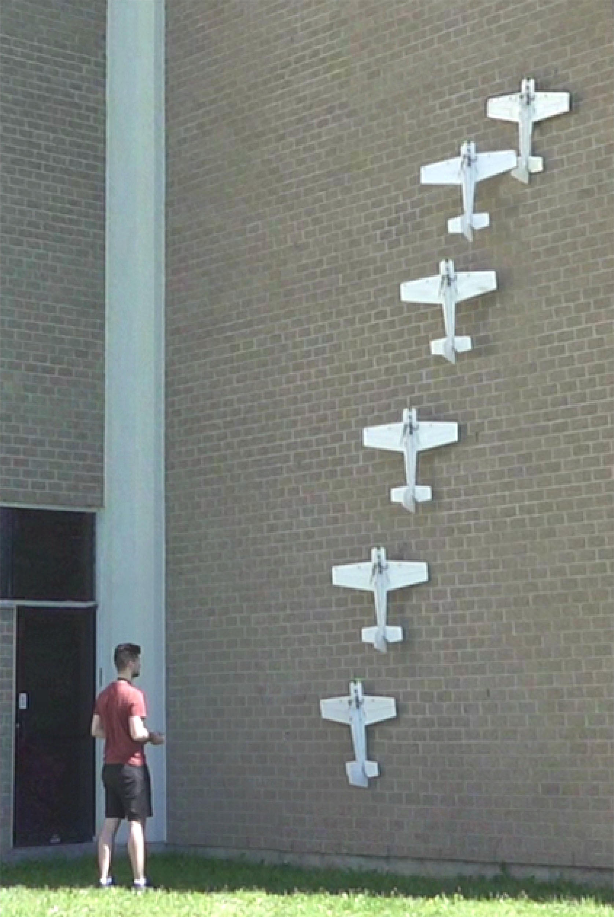
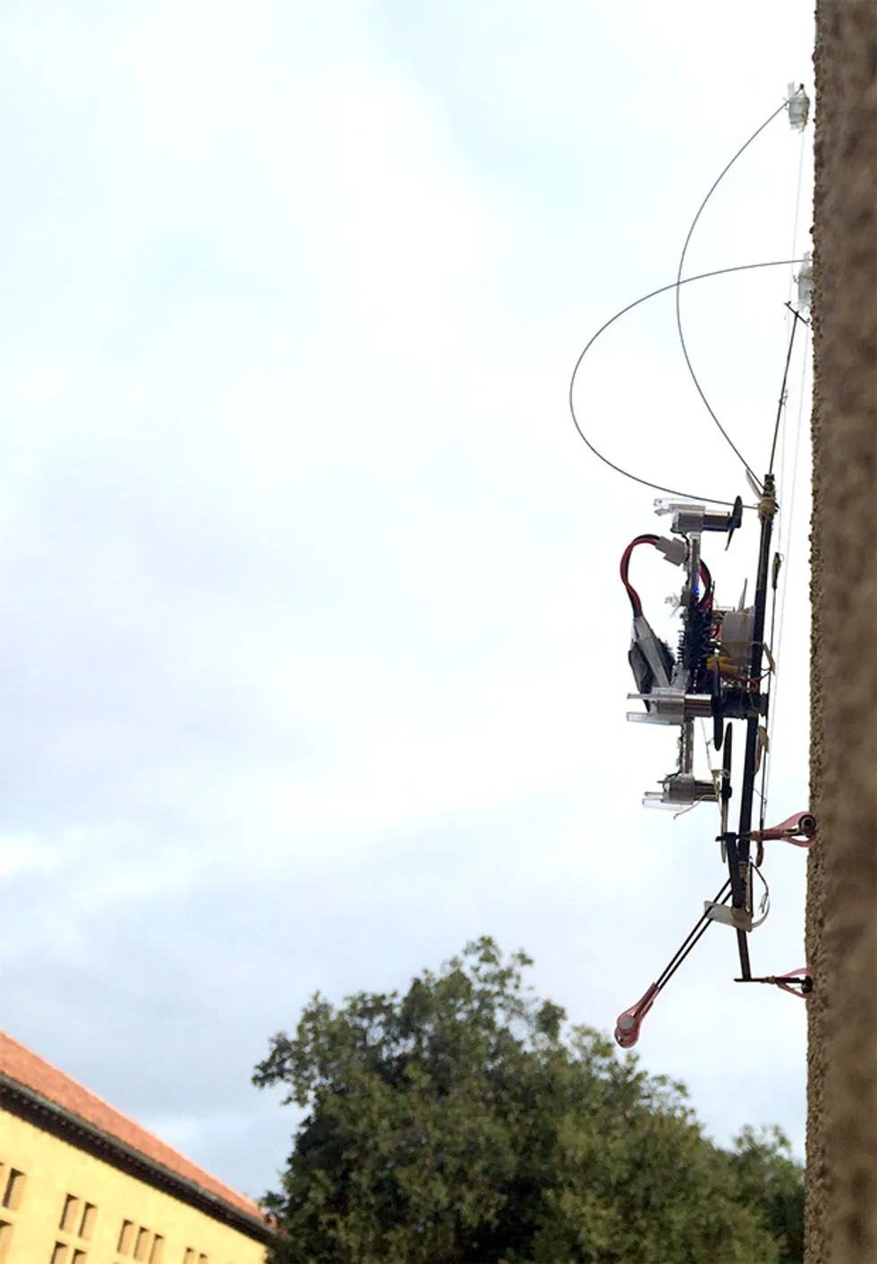
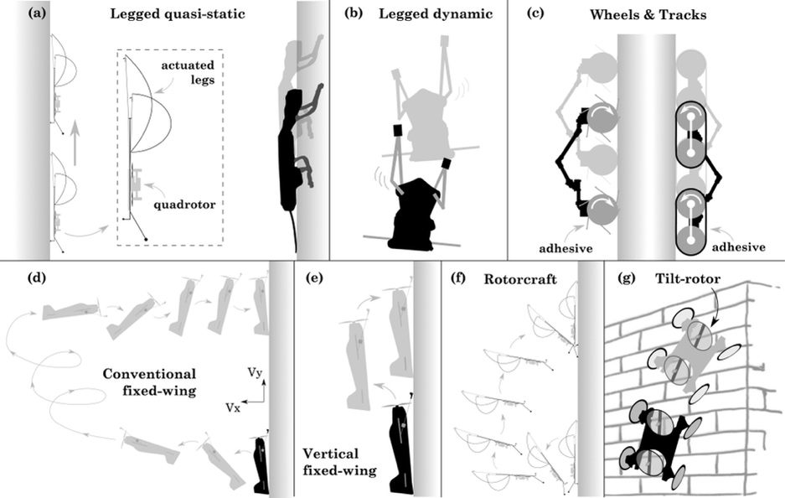
State of the art
[2]
Fixed-wing Drone Climbing
Legged methods (Scamp of Stanford)
Wheeled methods
Bio-inspired
[1]
[1]
[1] D. Mehanovic, D. Rancourt and A. L. Desbiens, "Fast and Efficient Aerial Climbing of Vertical Surfaces" , IEEE Robotics and Automation Letters (2018)
[2] M. T. Pope et al., "A Multimodal Robot for Perching and Climbing on Vertical Outdoor Surfaces," in IEEE Transactions on Robotics (2017)
Notes:
They call this climbing, hover controllably,
references everywhere (footnote side)
Name of authors, j.mina, title of paper. Journal publisher (conference), (year)
Citation [1], [2], and on pictures [1], [2]
State of the art, talk about limitation of each
What conclusions you draw, only there is one example of fixed wing climbing,
Examples with wheel,s with a projcte we investigated, not feasibke because of complexity of device
There thechnology where they dp climbing on the wall no directly applicable becausse wings are hugged we cannot climb, maybe we have to open up, when opening we might fall, so we need controller to sttay in hover, when we climb up also.
Not directly applicable to our casehand and feet a lot of mass and complexity and actutation, we have flying, they didn’t care about weight like us because were flying, only use of propeller.

Slide 4
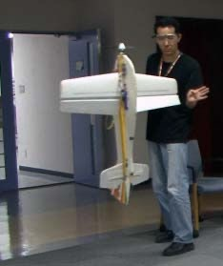
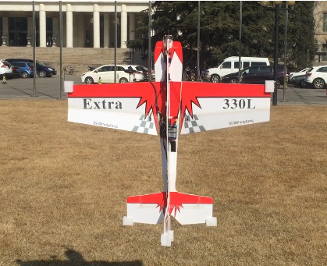

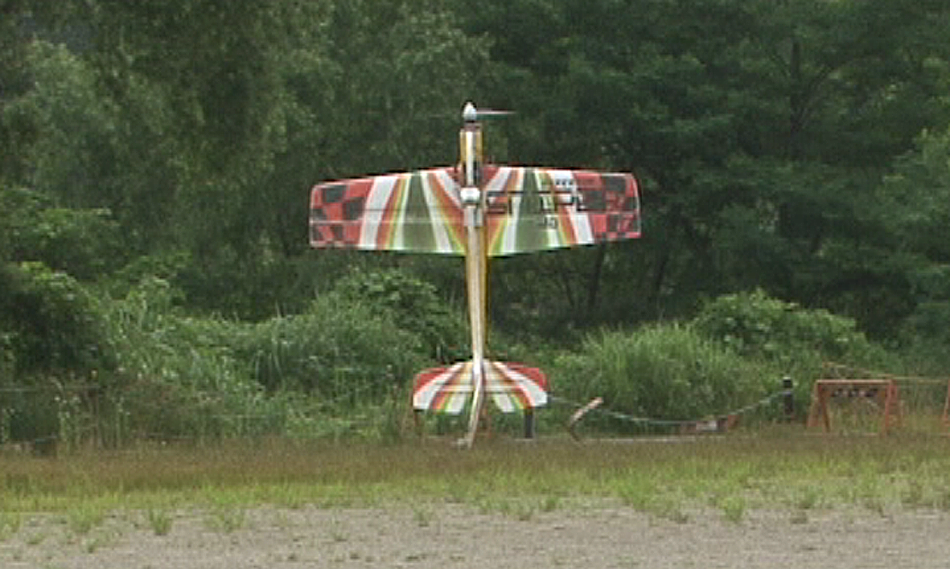
Previous Work on Hovering
[3]
[1]
Thrust vectoring
Detailed Models
PID, LQR controllers
Attitude Control
[2]
[1] Wang, W., Zhu, J., & Kuang, M. (2017). Design Modelling and Hovering Control of a Tail-sitter with Single Thrust-vectored Propeller. In 2017 IEEE/RSJ International Conference on Intelligent Robots and Systems (IROS).
[2] Kita, Koichi & Konno, Atsushi & Uchiyama, Masaru. (2009). Hovering Control of a Tail-Sitter VTOL Aerial Robot. Journal of Robotics and Mechatronics. 21. 277-283. 10.20965/jrm.2009.p0277.
[3] Matsumoto, T., Kita, K., Suzuki, R., Oosedo, A., Go, K., Hoshino, Y., Konno, A., & Uchiyama, M. (2010). A Hovering Control Strategy for a Tail-Sitter VTOL UAV that Increases Stability Against Large Disturbance. In Proceedings - IEEE International Conference on Robotics and Automation.

Slide 5
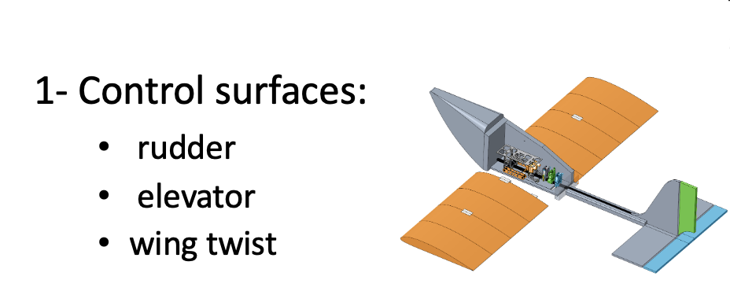
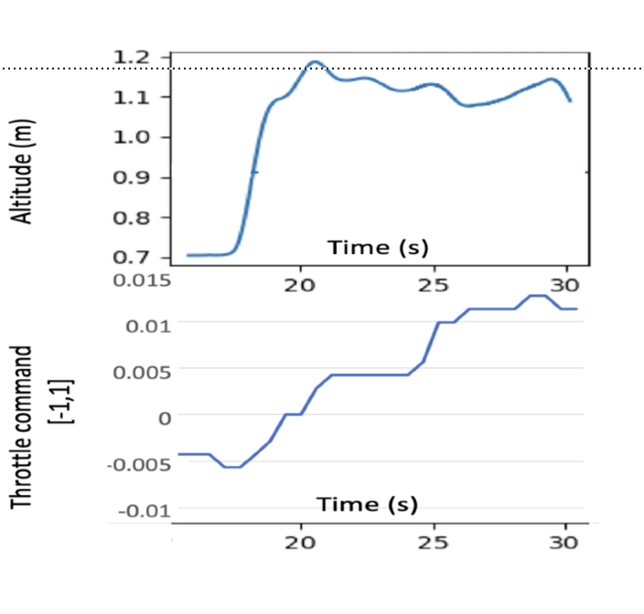

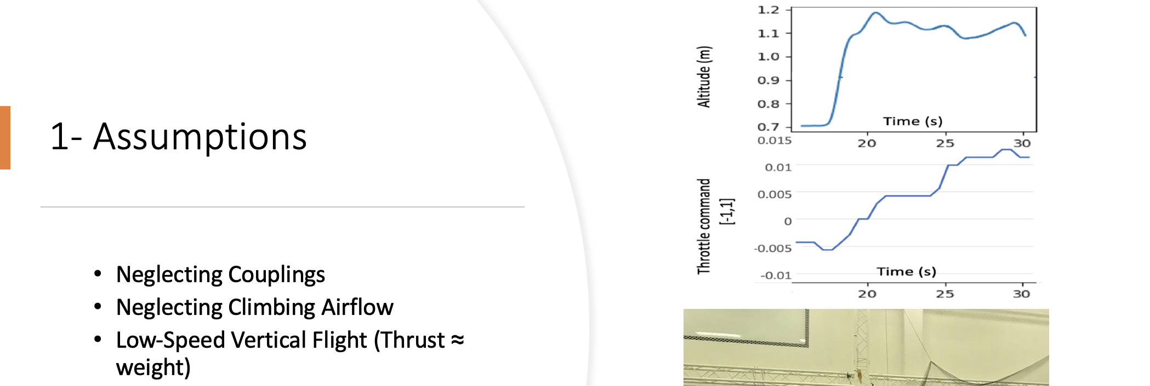
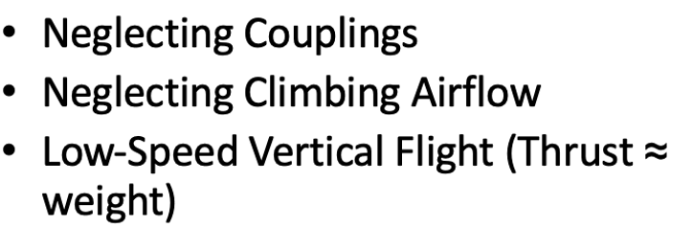
(Yaw)
(Pitch)
(Roll)
2-
3- Reference Frame

Slide 6
Control Approach
6 PIDs :
- X and Y cascaded PIDs
- Roll and Altitude PIDs
Notes:
References (10 papers, these two are most promising)v

Slide 7
Experimental Setup

Slide 8
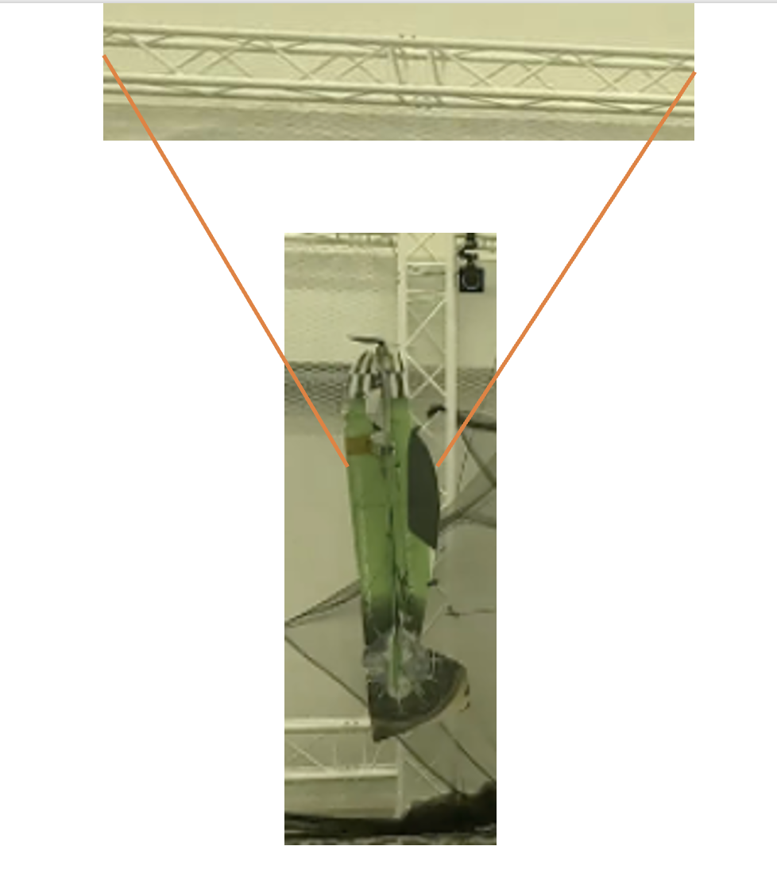
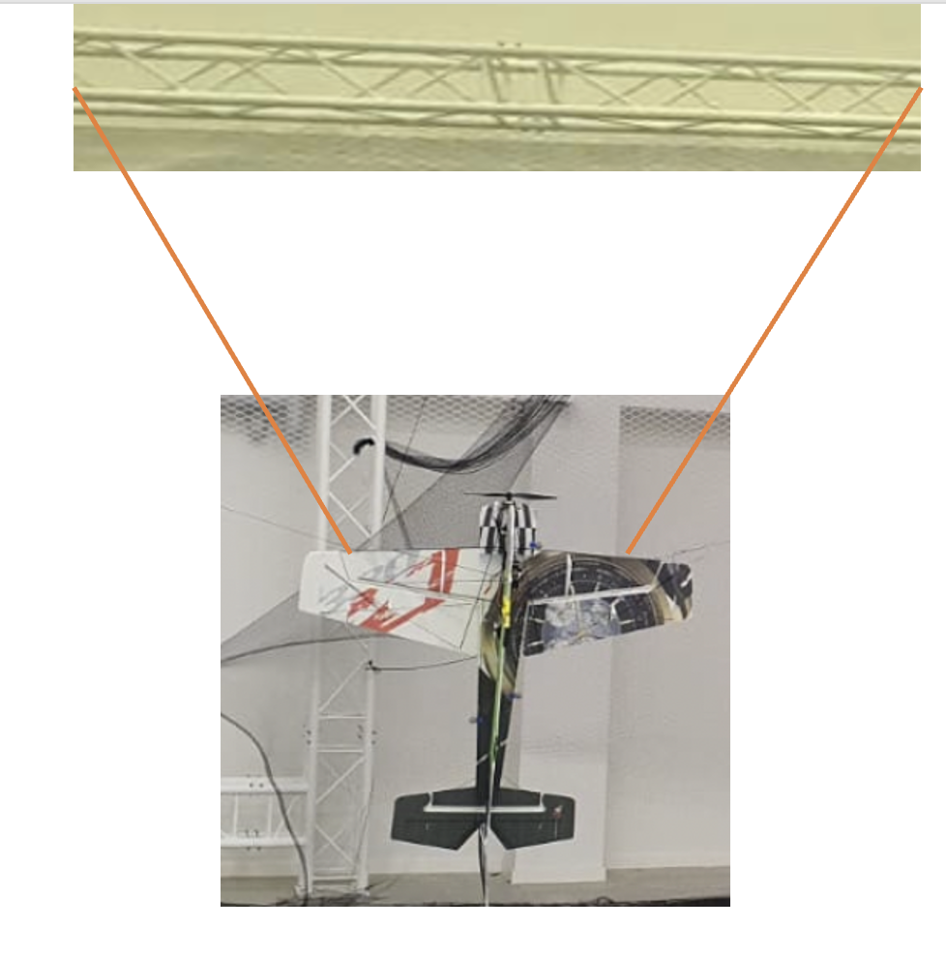
Tuning Approach
1- Restrict all but Pitch
2- Tune Pitch
3- Restrict all but Yaw
4- Tune Yaw
5- Tune Altitude
6- Tune Roll
7- Tune X and Y
8- Reiterate

Slide 9
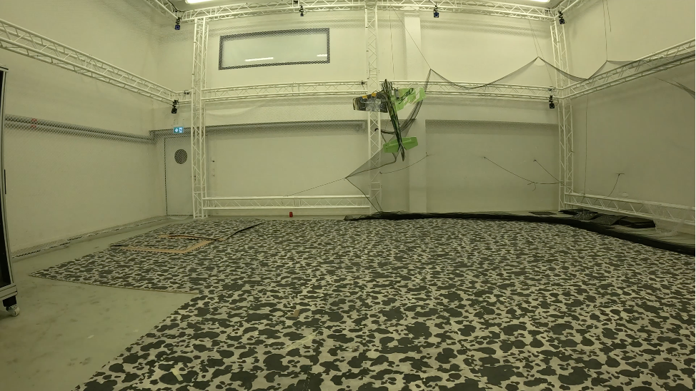
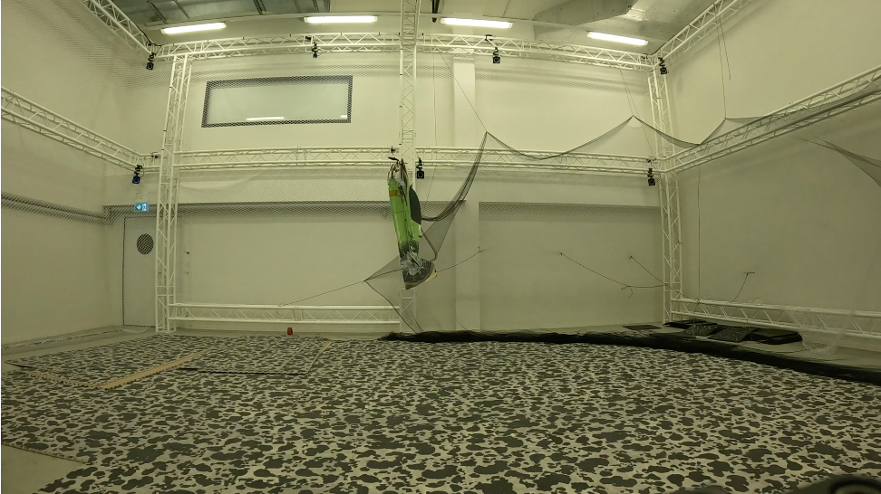
9/20

Slide 10
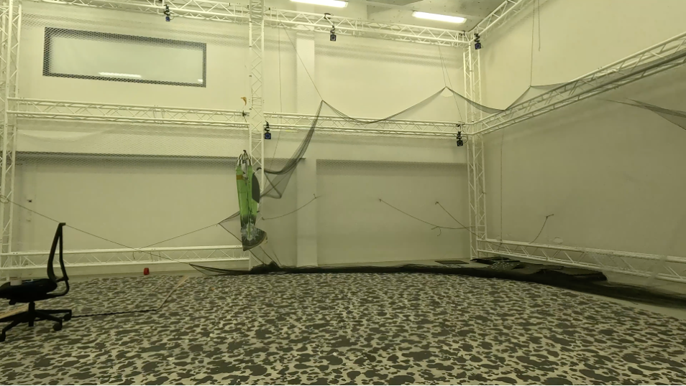

Experimental Results
Reference

